Slide 1
TL25 Dynamic Reactive LED Display, Lab 498 Products Inc.
Group Members:
Parth Arora
Rowan Baker-French
Candice Loo
Sanket Mittal
Jimmy Wong

Slide 2
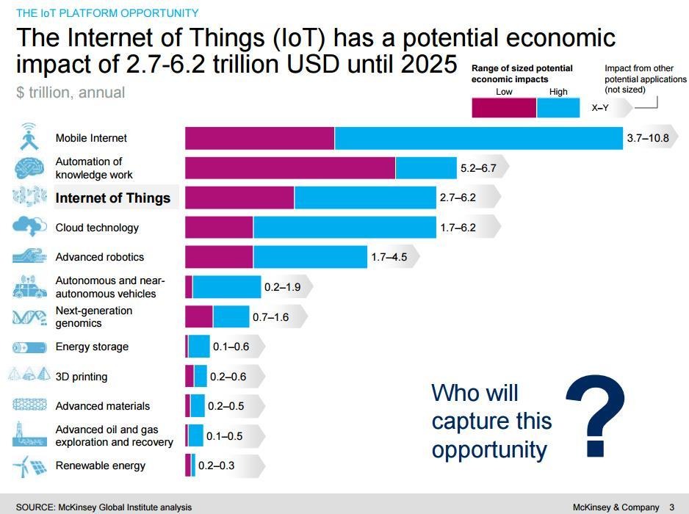
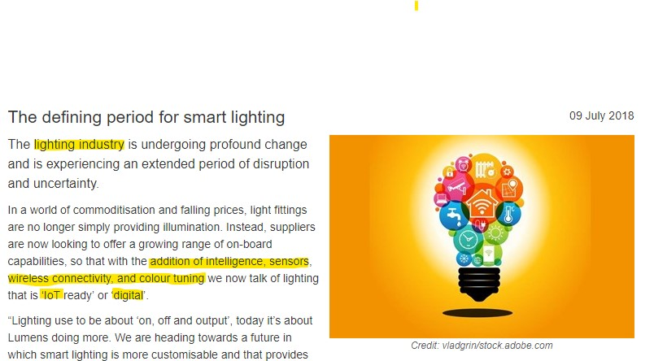
Notes:
https://www.google.com/search?biw=1366&bih=625&tbm=isch&sa=1&ei=gzleXIKvJvHz9APoxLhA&q=iot+market+size&oq=IOT+market+s&gs_l=img.3.0.0l6j0i5i30j0i8i30l3.440299.444636..445325...0.0..0.133.1469.17j4......1....1..gws-wiz-img.......35i39j0i67.x6dXY2IZ_mY#imgrc=BslOT5BtXpuHcM:
Talk about IOT market than
CAGR: Compound Annual Growth Rate.

Slide 3
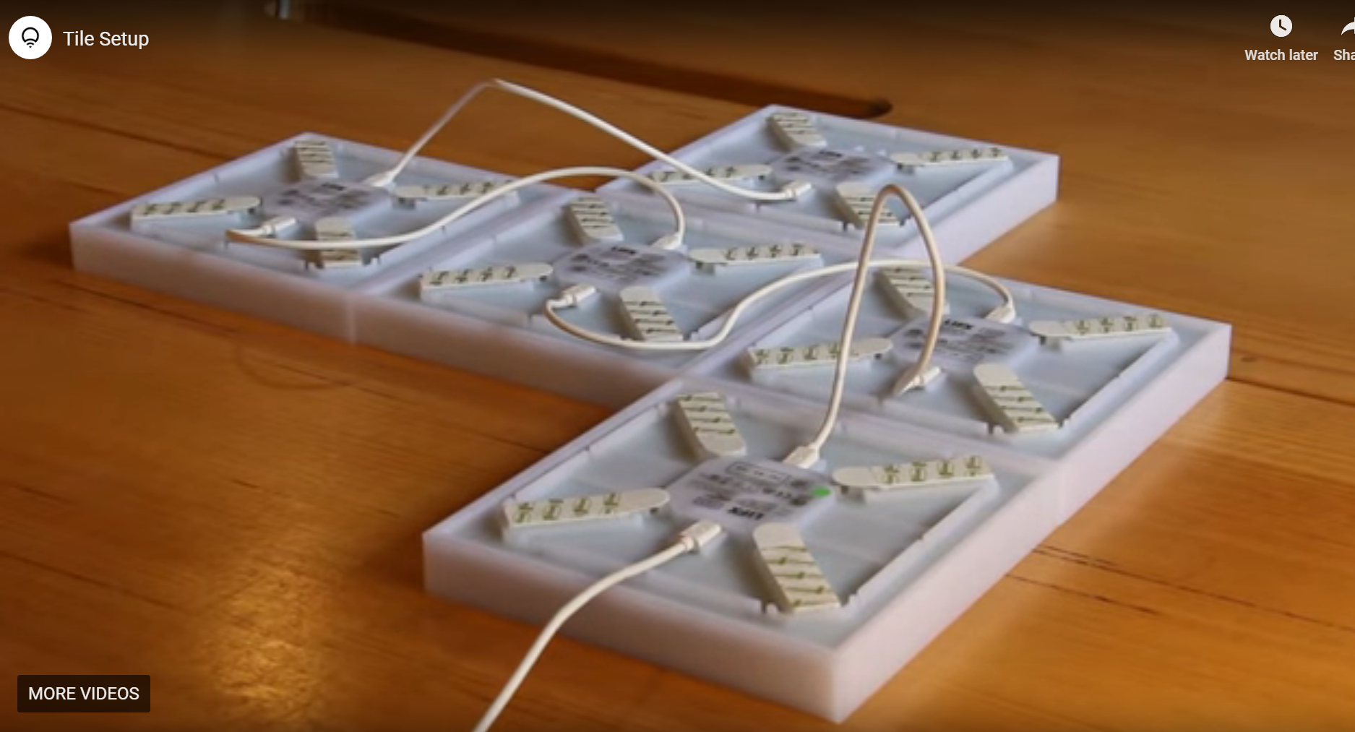
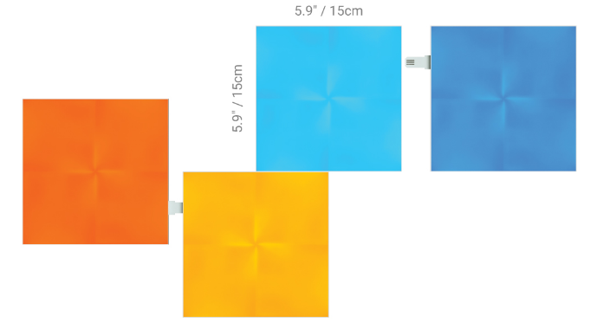
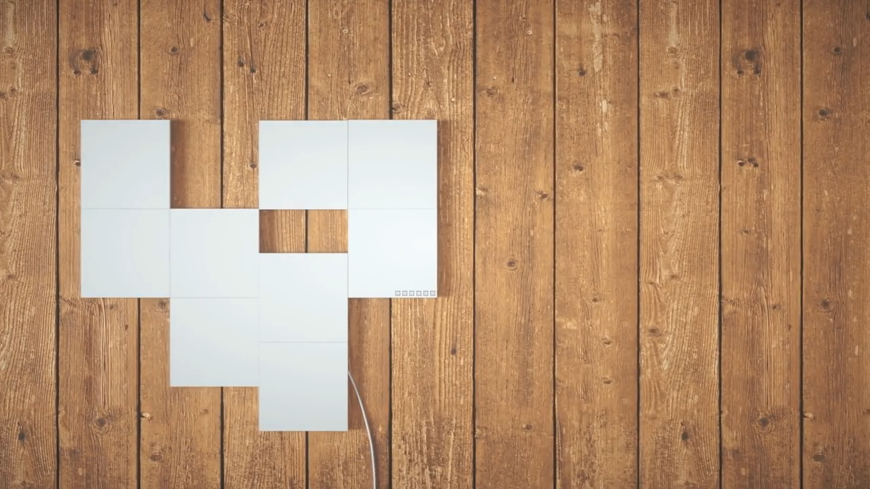
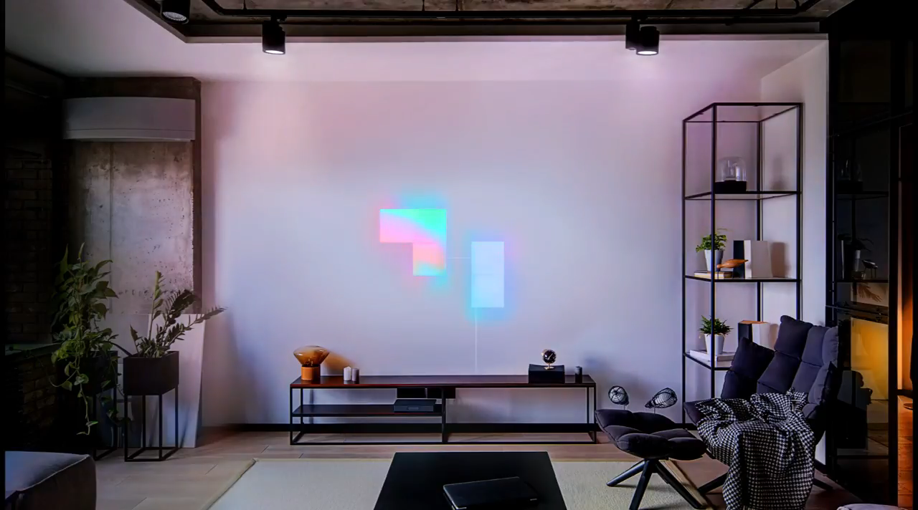
Competition
Nanoleaf Canvas
LIFX Tile
BASIC INTERACTION
Basic touch response
Single Color per light square
$300 for 9 light squares
No touch or gesture response
Upto 64 color zones per Tile
$250 for 5 Tiles
Cable management issues
CANNOT DISPLAY TEXT

Slide 4
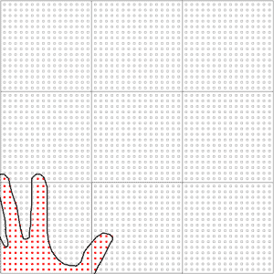
USE CASE: INTERACTIVE VISUAL SHOWPIECE
Tile is a visual work of art that you can show off to your friends and family. Turning an otherwise mundane wall into a visually stimulating, dynamic display.

Slide 5
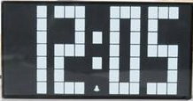
USE CASE 2: DISPLAY IMAGE AND TEXT
Display images and text
Weather
Clock

Slide 6
Interactive Modular LED Display Progress
Interactive LED display made by grouping “Tiles” together in various shapes and sizes.
Main features of the display:
Display Text:
Completion
~40%
Object Mirroring on LED Matrix :
Completion
~60%
Gesture control enabled :
Completion
~60%
Mobile connectivity enabled:
Completion
~60%
Plug and Play Tile addition:
Completion
~80%
Notes:
Parth

Slide 7
Project Requirements [1]
4.1 - Real Time Feedback
4.2 - Modularity
4.2.1 - Dynamic Addition and Removal of Tiles
4.2.2 - Unified Display
6.3 - Size
6.4 - Resolution
6.5 - Object Detection
6.5.1 Detection Resolution
6.5.2 Detection Distance
[1] Team 25, “TL25: KEY DOCUMENT Requirements”, Capstone Key Document, Team 25, November 2018

Slide 8
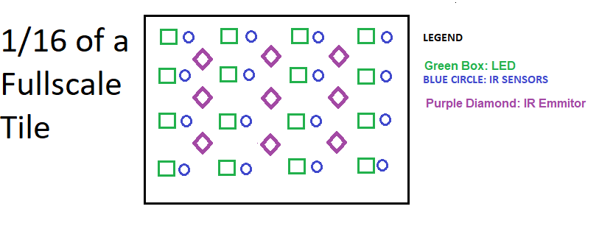
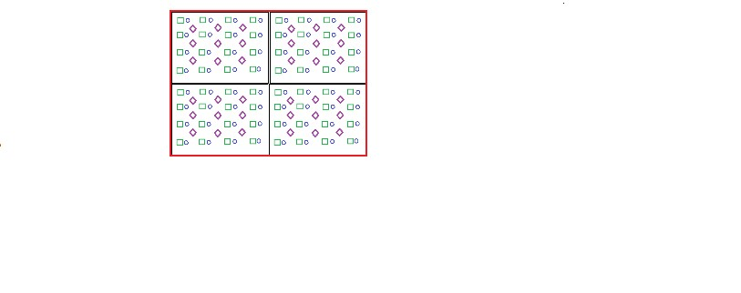
Test PCB
Single Tile
ELEMENTS
LED
IR sensor
IR Emitter
3.2 cm
Figure 1: Test PCB Layout
9.6 cm
Figure 2: Representation of ONE Tile
* 8x8 LED and IR Sensor/Emitter Matrix
Notes:
Sanket, mention how 13.6cm satisfies size requirement 6.3

Slide 9
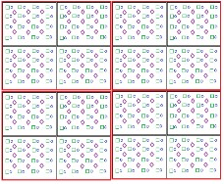
Final Demo: Four Tiles
What will it look like?
Four Tiles
Square configuration
Lies flat on the table
What will it do?
Move tiles into any shape at any time
Display projection of objects above surface
Display scrolling text
19 cm
19 cm
Notes:
Sanket

Slide 10
PCB design overview

Slide 11
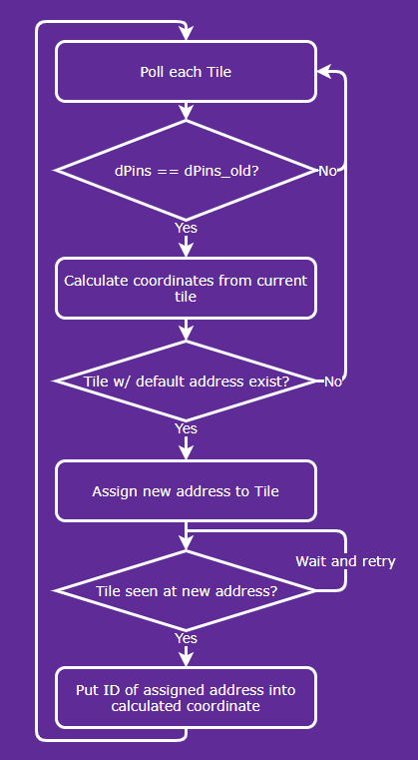
Mapping Algorithm
 |  |  | M | T1 | T2 | T3
Master Tile’s Internal Map of Devices

Slide 12
connectors and power design overview
Also Demo by parth

Slide 13
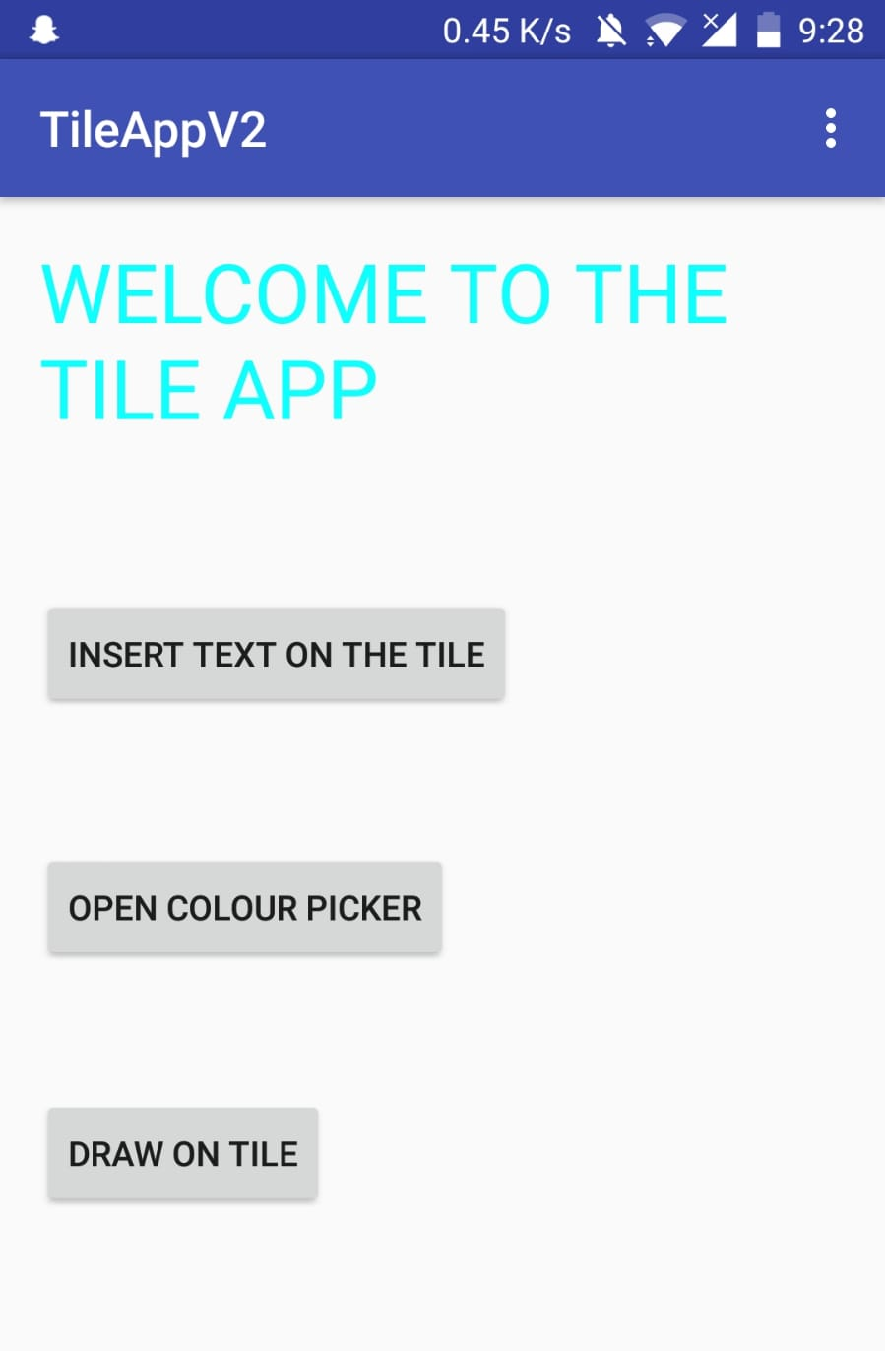

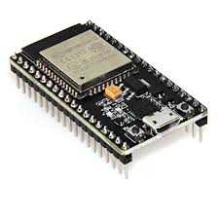
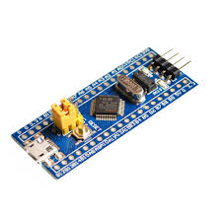
Wifi Connectivity Communication Pathway
Post Request
Get Request
STM32
UART
ESP32
I2C

Slide 14
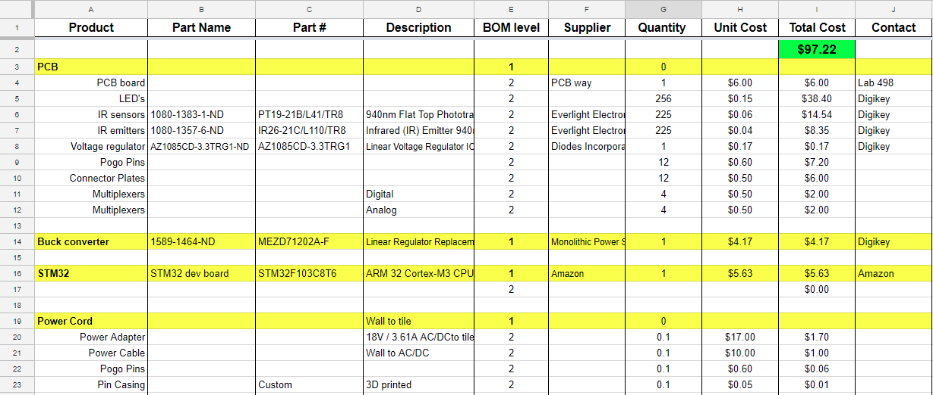
BOM
Comparable Products
Nanoleaf Light Panels
3 Pack $69.99
~ $23 each
Adafruit DotStar Matrix 8x8
$31.75 when buying 100+
$127 for 16x16
Notes:
PARTH

Slide 15
Thank you
We welcome any questions

